Slide 1
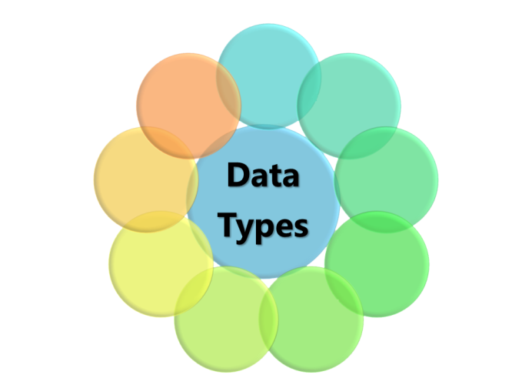
Data Types and Variables
Types of Operators
SoftUni Team
Technical Trainers
Software University
https://softuni.bg

Slide 2
Table of Contents
What is a data type?
Let vs. Var
Strings
Numbers
Booleans
Typeof operator
Undefined and Null

Slide 3
Have a Question?
sli.do
#fund-js

Slide 4
Let vs. Var
let var
Local vs. Global

Slide 5
Var and Let
var – variables use function scope – when declared inside a block {} can be accessed from outside the block
let – variables use block scope – when declared inside a block {} can NOT be accessed from outside the block
{ var x = 2; }
console.log(x); // 2
{ let x = 2; }
console.log(x); // Error

Slide 6
Variables Scope
The scope of a variable is the region of the program in which it is defined
Global Scope – Global variables can be accessed from anywhere in a JavaScript function
var carName = "Volvo"; // Code here can use carName function myFunction() { // Code here can also use carName }

Slide 7
Variables Scope (2)
Function Scope – Local variables can only be accessed from inside the function where they are declared
Block Scope - Variables declared inside a block {} can not be accessed from outside the block
function myFunction() { var carName = "Volvo"; // Only here code CAN use carName }
{ let x = 2; } // x can NOT be used here

Slide 8
Naming Variables
Variable names are case sensitive
Variable names must begin with a letter or underscore (_) character
Variable names can't be one of JavaScript's reserved words like: break, const, interface, typeof, true etc.
firstName, report, config, fontSize, maxSpeed
foo, bar, p, p1, LastName, last_name, LAST_NAME

Slide 9
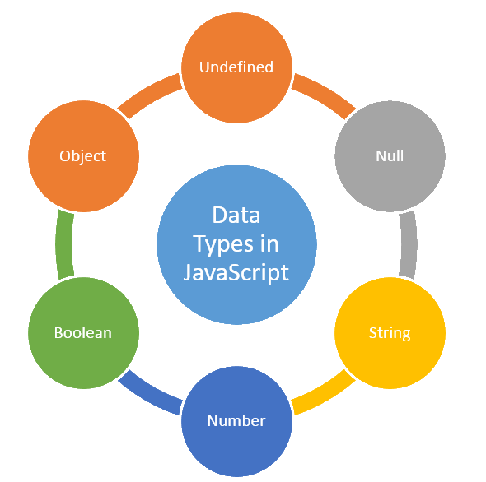
What is Data Type?
Definition and Examples

Slide 10
What is a Data Type?
A data type, is a classification that specifies which type of value a variable has and what type of operations can be applied to it
After ECMAScript 2015 there are seven primitive data types:
Seven primitive: Boolean, null, undefined, Number, String, Symbol, BigInt
and Objects (including Functions and Arrays)

Slide 11
Examples
Symbol
undefined
String
null
Data Types
Boolean
Array
Number
Object
let number = 10; // Number
let name = 'George'; // String
let array = [1, 2, 3]; // Array
let isTrue = true; // Boolean
let person = {name: 'George', age: 25}; // Object
let empty = null; // null
let unknown = undefined; // undefined

Slide 12
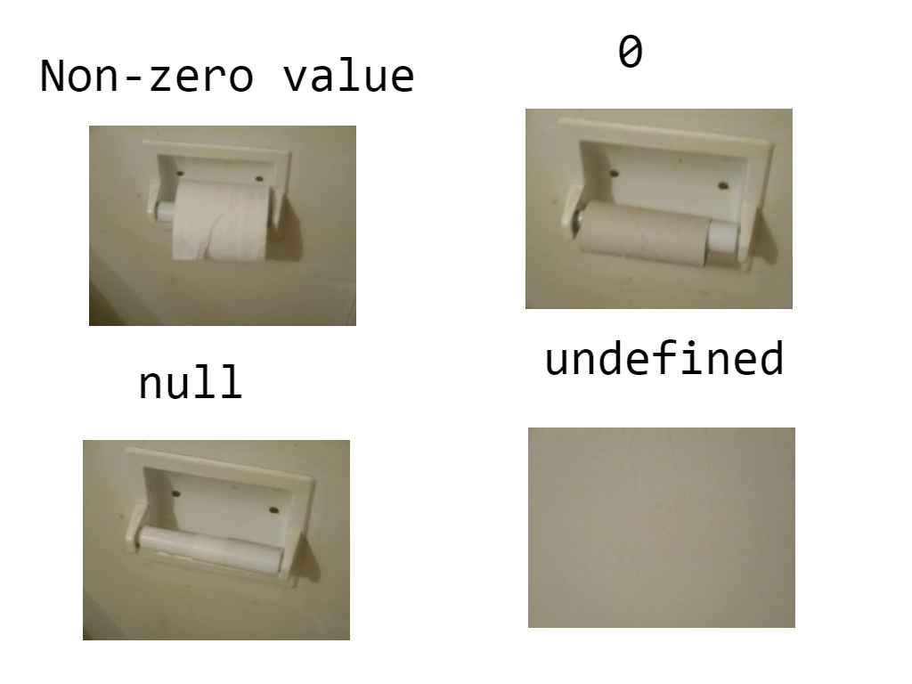
Data Types Comparison Chart

Slide 13
Dynamic Typing
Variables in JavaScript are not directly associated with any particular value type
Any variable can be assigned (and re-assigned) values of all types
NOTE: The use of dynamic typing is considered a bad practice!
let foo = 42; // foo is now a number
foo = 'bar'; // foo is now a string
foo = true; // foo is now a boolean

Slide 14
Typeof Operator
typeof
Checking for a Type

Slide 15
Definition and Examples
Used to find the type of a variable
Returns the type of a variable or an expression:
console.log(typeof "") // Returns "string" console.log(typeof "John") // Returns "string" console.log(typeof "John Doe") // Returns "string"
console.log(typeof 0) // Returns "number"
let number = 5;
if (typeof(n) === 'number') {
console.log(number); // 5
}

Slide 16
Strings
'ABC'
Sequence of Characters

Slide 17
What is a String?
Used to represent textual data
Each symbol occupies a position in the String
The first element is at index 0, the next at index 1, and so on
The length of a String is the number of elements in it
let name = 'George';
console.log(name[0]); // 'G'
Accessing element at index

Slide 18

Strings Are Immutable
Unlike in languages like C, JavaScript strings are immutable
This means that once a string is created, it is not possible to modify it
let name = 'George';
name[0] = 'P';
console.log(name) // 'George'

Slide 19
String Interpolation
In JS we can use template literals. These are string literals that allow embedded expressions
let name = 'Rick';
let age = 18;
console.log(`${name} = ${age}`); // 'Rick = 18'
Place your variables after the '$' sign

Slide 20
Problem: Concatenate Names
Receive two names as string parameters and a delimiter
Print the names joined by the delimiter
'John', 'Smith', '->'
John->Smith
'Jan', 'White', '<->'
Jan<->White
function solve(first, second, del) {
console.log(`${first}${del}${second}`);
}
solve('John', 'Wick', '***')

Slide 21
Problem: Right Place
You will receive 3 parameters (string, symbol, string)
Replace the underscore '_' in the first word with the symbol
Compare both strings and print "Matched" or "Not Matched"
'Str_ng', 'I', 'Strong'
function solve(str, symbol, result) {
let res = str.replace('_', symbol);
let output = res ===
result ? "Matched" : "Not Matched";
console.log(output);
}
Not Matched
'Str_ng', 'i', 'String'
Matched
solve('Str_ng', 'I', 'Strong')

Slide 22
Numbers
123
Integer, Float, Double – All in One

Slide 23
What is a Number?
There is no specific type for integers and floating-point numbers
To represent floating-point numbers, the number type has three symbolic values: +Infinity, -Infinity, and NaN (not-a-number)
let num1 = 1;
let num2 = 1.5;
let num3 = 'p';
console.log(num1 + num2) // 2.5
console.log(num1 + num3) // '1p'
console.log(Number(num3)) // NaN
Concatenation
Trying to parse a string

Slide 24
Problem: Integer or Float
You will receive 3 numbers
Find their sum and print "{Sum} – {Integer or Float}"
9, 100, 1.1
function solve(num1, num2, num3) {
let sum = num1 + num2 + num3;
let output = sum % 1 === 0
? sum + ' - Integer'
: sum + ' - Float';
console.log(output);
}
110.1 - Float
100, 200, 303
603 - Integer
122.3, 212.3, 5
solve(112.3, 212.3, 5)
339.6 - Float

Slide 25
Booleans
true false
Conditions, Truthy and Falsy values

Slide 26

What is a Boolean?
Boolean represents a logical entity and can have two values: true and false
You can use the Boolean() function to find out if an expression (or a variable) is true:
Or even easier:
Boolean(10 > 9) // Returns true
(10 > 9) // Also returns true 10 > 9 // Also returns true

Slide 27
Comparisons and Conditions
Operator | Description | Example
== | equal to (no type) | if (day == 'Monday')
> | greater than | if (salary > 9000)
< | less than | if (age < 18)
=== | equal to (with type) | if (5 === 5)
>= | greater than or equal (no type) | if (6 >= 6)
!== | not equal (with type) | if (5 !== '5')
!= | not equal (no type) | if (5 != 5)

Slide 28

Booleans Examples
Everything with a "value" is true
Everything without a "value" is false
let number = 1;
if (number) {
console.log(number) // 1
}
true
let number;
if (number) {
console.log(number)
} else {
console.log('false') // false
}
false

Slide 29

Booleans Examples (2)
let x = 0;
Boolean(x); // false
let x = -0;
Boolean(x); // false
let x = '';
Boolean(x); // false
let x = false;
Boolean(x); // false
let x = null;
Boolean(x); // false
let x = 10 / 'p';
Boolean(x); // false

Slide 30
Problem: Amazing Numbers
You will receive a number, check if it is amazing
An amazing is a number, whose sum of digits includes 9
Print it in format "{number} Amazing? {True or False}"
1233
1233 Amazing? True
999
999 Amazing? False

Slide 31
Solution: Amazing Numbers
function solve(num) {
num = num.toString();
let sum = 0;
for(let i = 0; i < num.length; i++)
sum += Number(num[i]);
let result = sum.toString().includes('9');
console.log(result ? `${num} Amazing? True`
: `${num} Amazing? False`);
}

Slide 32
Undefined and Null
Undefined Null
Non-Existent and Empty

Slide 33
Undefined
A variable without a value, has the value undefined. The typeof is also undefined
A variable can be emptied, by setting the value to undefined. The type will also be undefined
let car; // Value is undefined, type is undefined
let car = undefined; // Value is undefined, type is undefined

Slide 34
Null
Null is "nothing". It is supposed to be something that doesn't exist
The typeof null is an object
let person = {
firstName:"John",
lastName:"Doe",
age:50
};
person = null;
console.log(person); // null
console.log(typeof(person)); // object

Slide 35
Null and Undefined
Null is an assigned value. It means nothing
Undefined typically means a variable has been declared but not defined yet
Null and Undefined are falsy values
Undefined and Null are equal in value but different in type:
null !== undefined // true
null == undefined // true

Slide 36

Live Exercises

Slide 37

Summary
There are 7 data types in JavaScript: Number, String, Symbol, Null, Undefined, Object, Boolean
let has block scope, var has function scope
With typeof we can receive the type of a variable
Null is "nothing", undefined exists, but is empty
…
…
…

Slide 38
Questions?
Notes:
38

Slide 39










SoftUni Diamond Partners

Slide 40



Educational Partners

Slide 41
Trainings @ Software University (SoftUni)
Software University – High-Quality Education, Profession and Job for Software Developers
softuni.bg
Software University Foundation
softuni.foundation
Software University @ Facebook
facebook.com/SoftwareUniversity
Software University Forums
forum.softuni.bg
Notes:
41

Slide 42

License
This course (slides, examples, demos, exercises, homework, documents, videos and other assets) is copyrighted content
Unauthorized copy, reproduction or use is illegal
© SoftUni – https://about.softuni.bg/
© Software University – https://softuni.bg
Notes:
42

